Slide 1
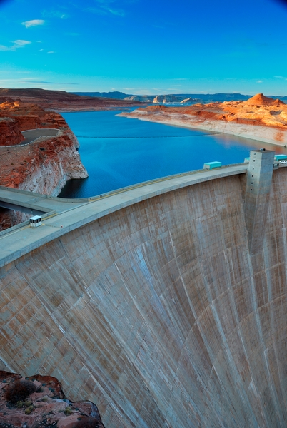


Terms Extension Opportunity Assessment
July 2024

Slide 2
Situation Summary
Situation Summary for American Water
We understand that American Water is looking to optimize its working capital position with Taulia’s holistic Working Capital Management platform.
Taulia analyzed $1.23B USD spend across American Water’s supplier relationships to highlight the working capital trapped within its supply chain.
Highlights:
* Total potential working capital within American Water’s existing supply chain is ~$609.76M based on 100% extension adoption.
* Significant discount potential with peak liquidity demand at APR 6 with $1.4M gross yield.
* Taulia expects American Water to generate ~$609.76M across its top-10 largest supplier industry groups.
By aligning payment terms with industry norms and leveraging Taulia’s platform, American Water can unlock significant working capital and efficiency gains.
© 2023 Taulia LLC. Confidential information. Do not distribute.

Slide 3
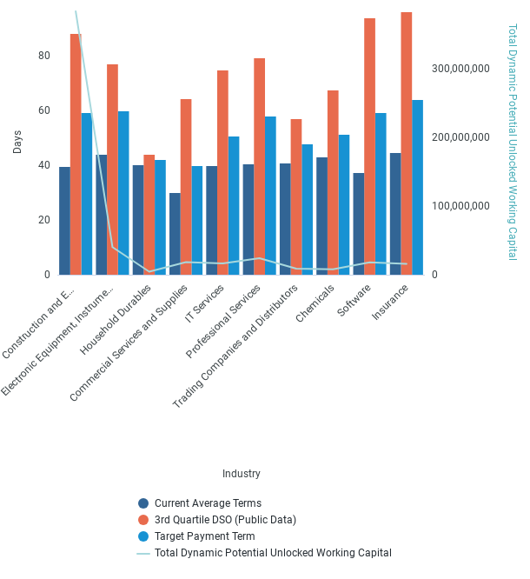
Industry Term Comparison
American Water is 28.5 days behind industry norms across its top 10 industries.
© 2023 Taulia LLC. Confidential information. Do not distribute.

Slide 4
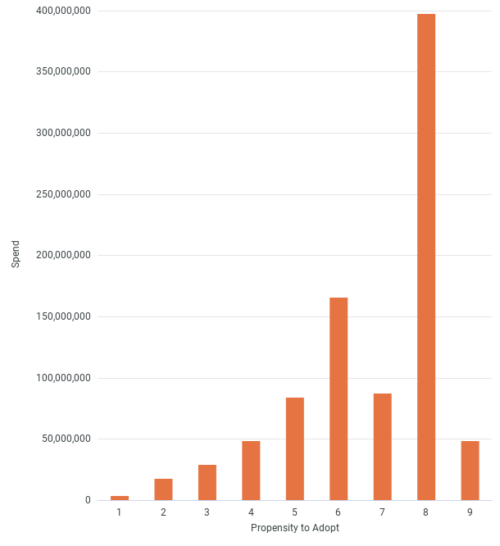
Card Adoption
© 2023 Taulia LLC. Confidential information. Do not distribute.

Slide 5
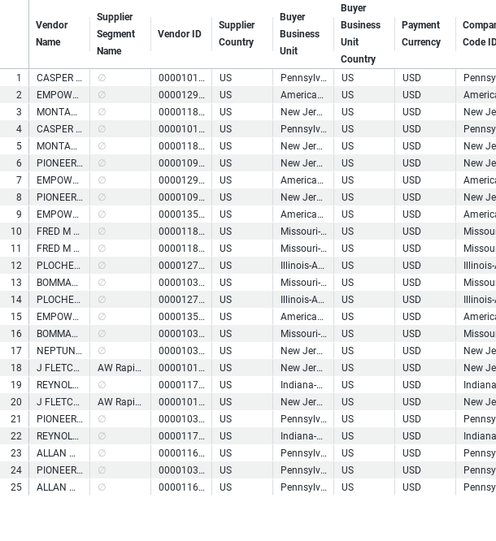
Top WC Potential Suppliers
© 2023 Taulia LLC. Confidential information. Do not distribute.

Slide 6
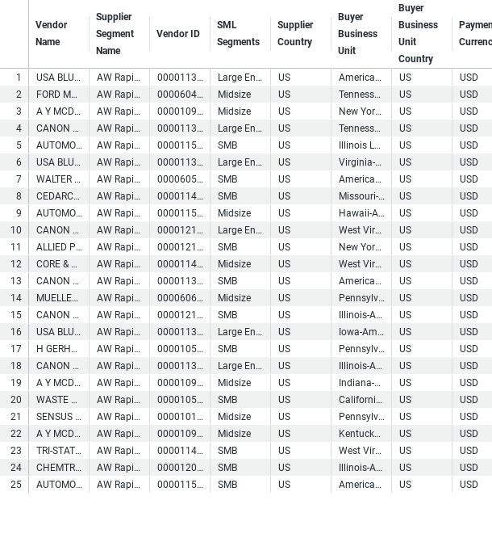
Buyer - Payables Planner Supplier List
© 2023 Taulia LLC. Confidential information. Do not distribute.

Slide 7
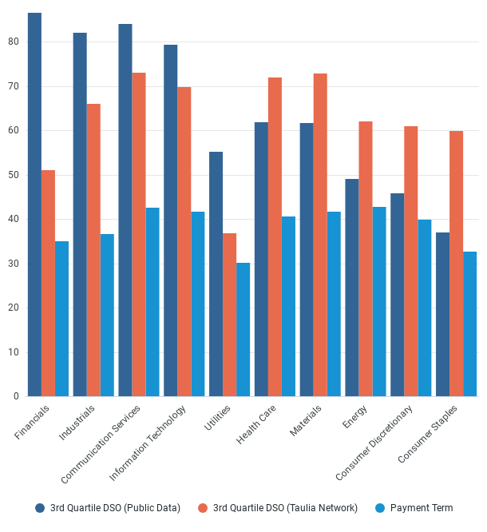
Supplier Payment Terms Comparison
© 2023 Taulia LLC. Confidential information. Do not distribute.

Slide 8
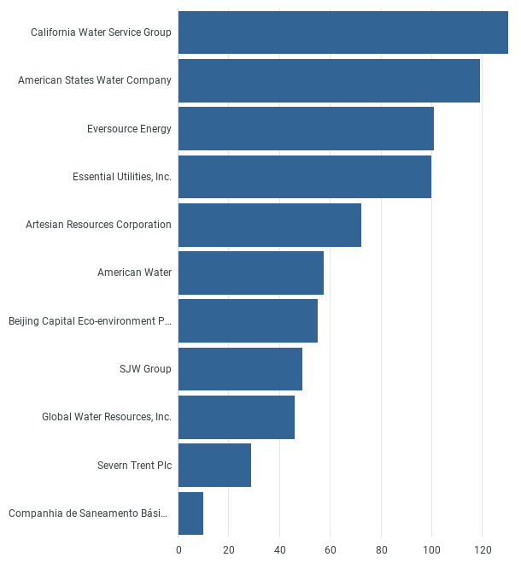
Peer DPO
American Water is 25.45 days below the peer group average in Days Payables Outstanding (DPO).
© 2023 Taulia LLC. Confidential information. Do not distribute.

Slide 9
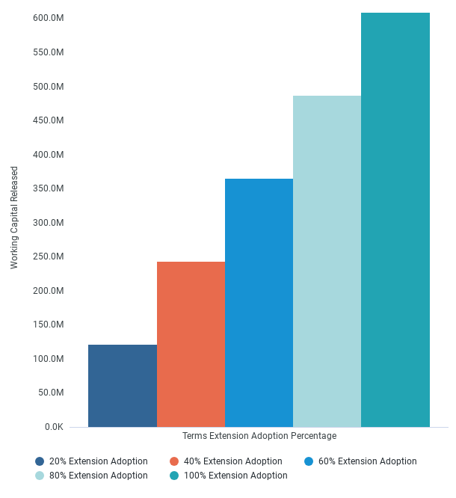
Working Capital Released
American Water can unlock approximately $609.76MM in working capital.
© 2023 Taulia LLC. Confidential information. Do not distribute.

